Slide 1



Entropy-Score: A Method to Detect DDoS Attack and Flash Crowd
Saar Ben Yochana - *********
Efi Korenfeld - *********

Slide 2

Overview
Many popular servers are constantly facing the inability to distinguish between Normal Operations, Flash Crowd traffic and DDoS Attacks
DDoS Attack – Distributed Denial of Service Attack is a cyber-attack in which the attacker can make the server unavailable for serving legitimate clients by flooding requests from multiple sources
Flash Crowd – An increase in traffic to a particular server causing a dramatic growth in load and service time Usually occurs when a new launched feature is causing worldwide interest

Slide 3
Overview
Entropy - Measurable property that describes the degree of disorder, randomness or uncertainty of the system
Entropy based solutions are available today, but they cannot distinguish between flash crowd and DDoS attack
The article proposes a combined method consisting of packet scoring and entropy calculation, to distinguish between malicious network traffic and mass crowd traffic

Slide 4


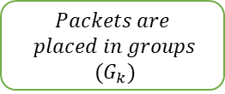

Detection Algorithm
$$Incoming$$
$$Packets (P_{k})$$
$$Packets are$$
$$placed in groups$$
$$(G_{k})$$
$$Calculation of$$
$$Entropy (H)$$
Phase 1: Packets will be divided into groups according to 'Distance' parameter and their IP address
Phase 2: Entropy calculation of the system which is done by Equation 1. In the article:
$$Entropy\left(H\right)=−\sum_{X}{\left\{p\left(x_{i}\right)\log_{2}\left(p\left(x_{i}\right)\right)\right\}}$$
Where $X$ is the total sample space and $p\left(x_{i}\right)$ is the probability of $i^{th}$ sample occurrence

Slide 5






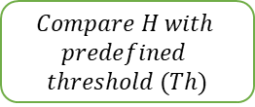




Detection Algorithm
$$S_{k}>T$$
$$Incoming$$
$$Packets (P_{k})$$
$$Score \left(S_{k}\right) of each$$
$$group is calculated$$
$$and compared with$$
$$threshold_{2 }(T)$$
$$Packets are$$
$$placed in groups$$
$$(G_{k})$$
$$Calculation of$$
$$Entropy (H)$$
$$Compare H with$$
$$predefined$$
$$threshold (Th)$$
$$H>Th$$
$$DDoS$$
$$Attack$$
$$Detected$$
$$H≤Th$$
$$S_{k}≤T$$
$$Insight:$$
$H_{no attack}<$ $H_{DDoS attack}<$ $H_{Flash crowd}$
Means that IP addresses scattering is the lowest for Normal Operations and highest for Flash Crowd
$$Score \left(S_{k}\right) of each$$
$$group is calculated$$
$$and stored in score$$
$$book$$
$$Flash Crowd$$
$$Detected$$
Phase 3: Compare entropy value versus the threshold:
If the entropy is less than the threshold, then traffic is classified as normal
Else, further distinguishing between DDoS and FC traffic is required
Phase 4: Score of each group is calculated and compared with Packet Score Threshold (T):
If the score is less than the threshold, then traffic is classified as Flash Crowd
Else, traffic is classified as DDoS Attack

Slide 6
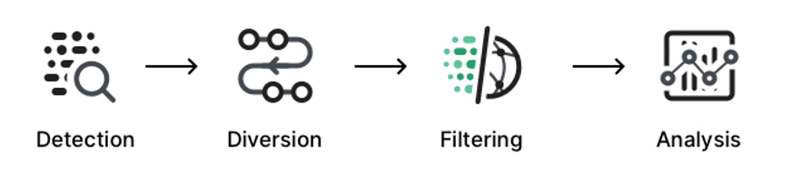
Simulation Goal
The main goal of the simulation is to test the correctness and efficiency of the suggested method to differentiate between DDoS Attack and Flash Crowd
IP addresses
Distance
Thresholds
Pre-defined Types

Slide 7
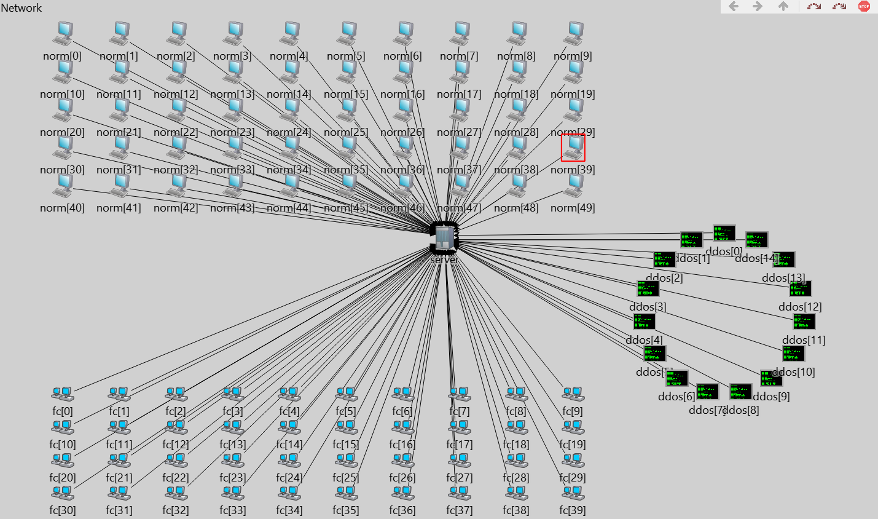
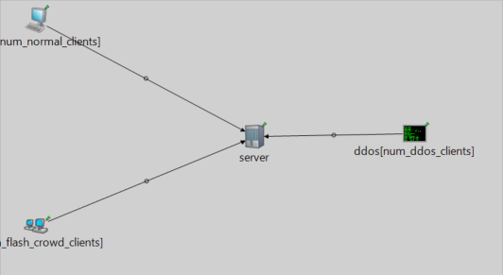

Our Implementation
Network:

Slide 8
Our Implementation
Assumptions:
IP addresses are scattered randomly according to article’s insight
Center of each group is calculated dynamically per insertion
Distance parameter was statically defined (29)
Entropy threshold was set as the upper bound entropy value for the number of normal groups created
Packet Score Threshold was statically set as 15 according to article’s results
Number of requests for each client - according to article described experiment

Slide 9
The Simulation
Initialization: Clients are divided to three different types – Normal, DDoS and FC
First Phase - Normal Operation: 50 normal clients generate requests towards the server causing dynamic groups creation At the end of this phase, the system’s entropy value is calculated and recorded, then the entropy threshold is set

Slide 10
The Simulation
Second Phase - DDoS Attack: 15 DDoS clients generate requests towards the server. At the end of this phase , we calculated and recorded the system’s entropy value and packet score values for each DDoS group
Third Phase - FC Scenario: 40 FC clients generate requests towards the server. At the end of this phase, we calculated and recorded the system’s entropy value and packet score values for each FC group

Slide 11
The Simulation
Classification:
Each group is classified according to the algorithm
Correctness is verified by comparing the classification tag versus the pre-defined group type

Slide 12
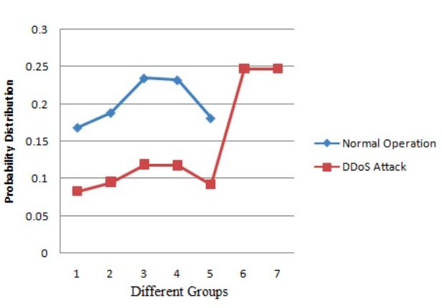
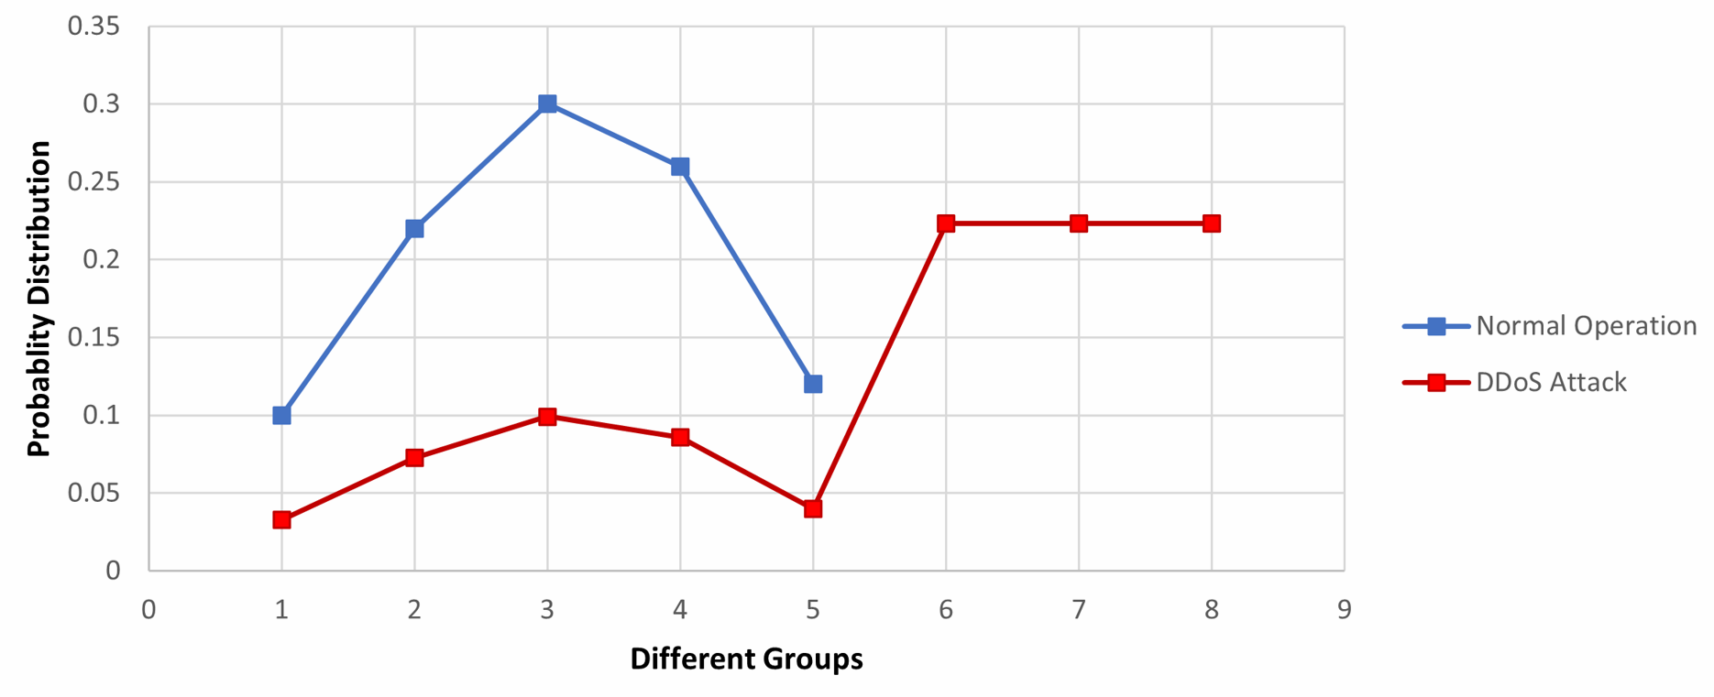
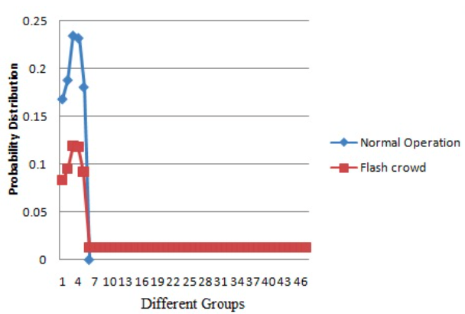
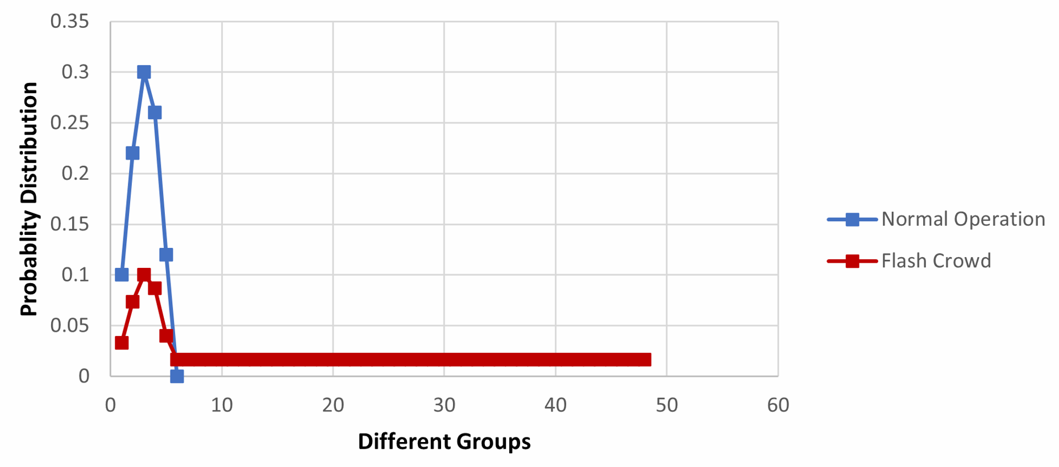
Results
Article’s Results
Our Results

Slide 13
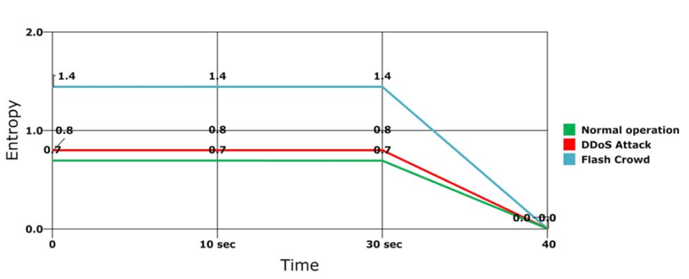
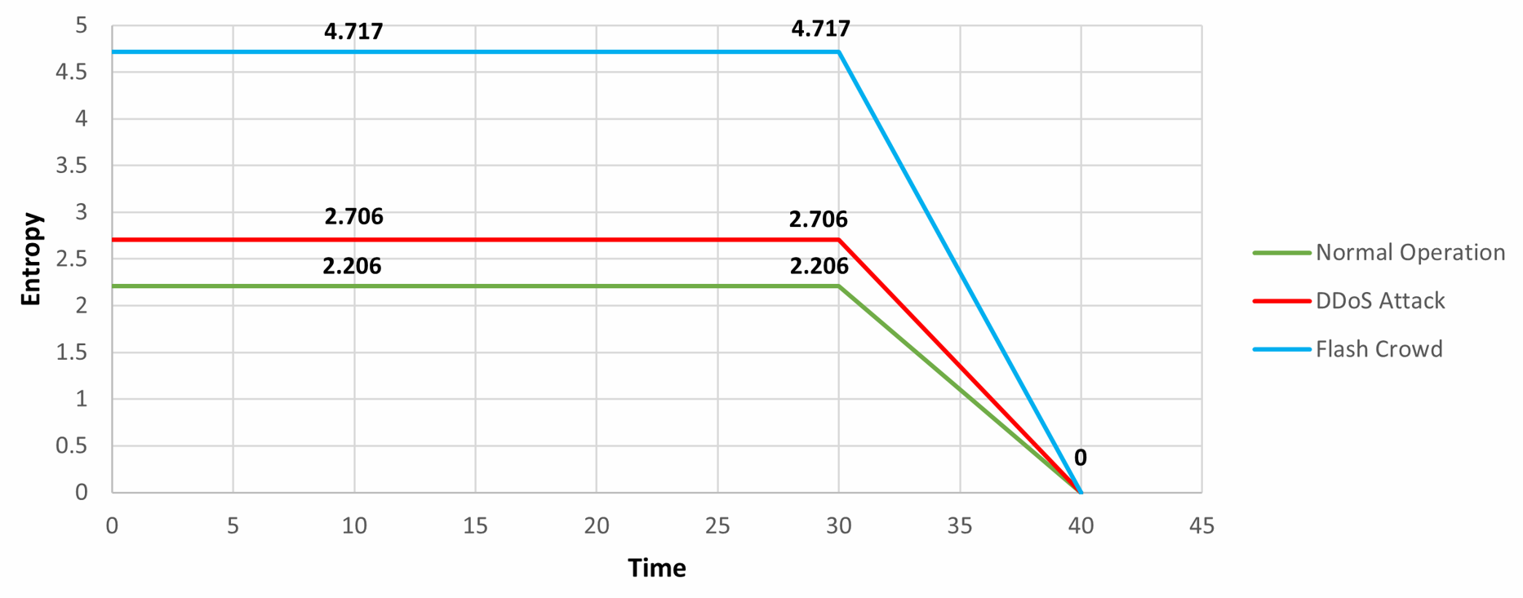
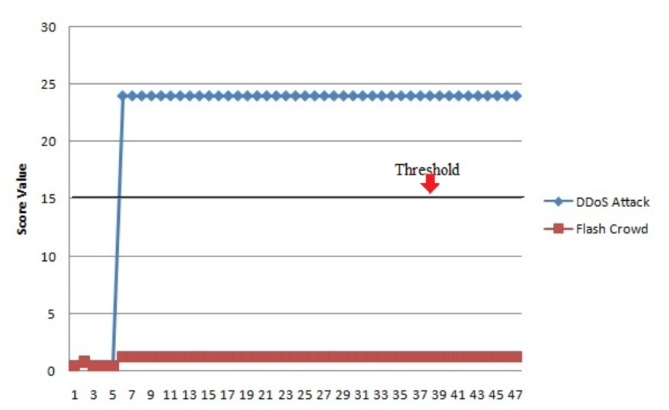
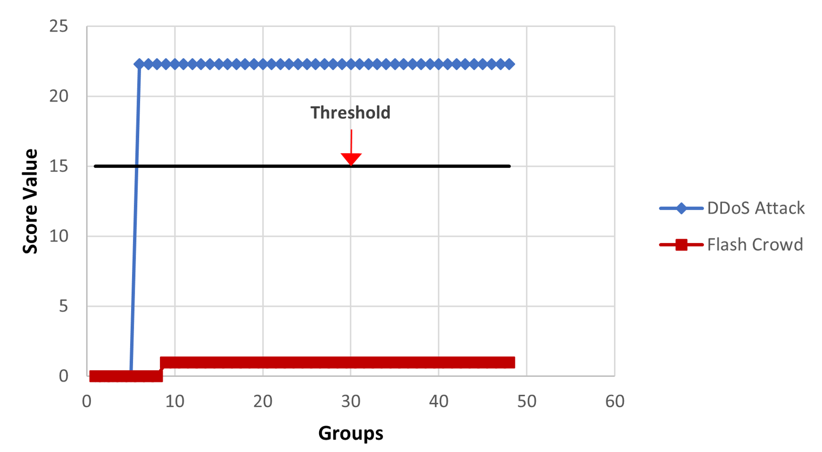
Results
Article’s Results
Our Results

Slide 14
Conclusions
The algorithm method seems to be efficient and correct
In order to implement the algorithm correctly, it is required to know the system’s normal behavior and to set the right threshold parameters
In real time scenario the algorithm can detect DDoS attacks in a relatively short time interval and can be used to prevent it without blocking FC traffic

Slide 15

Thank You!

